Slide 1


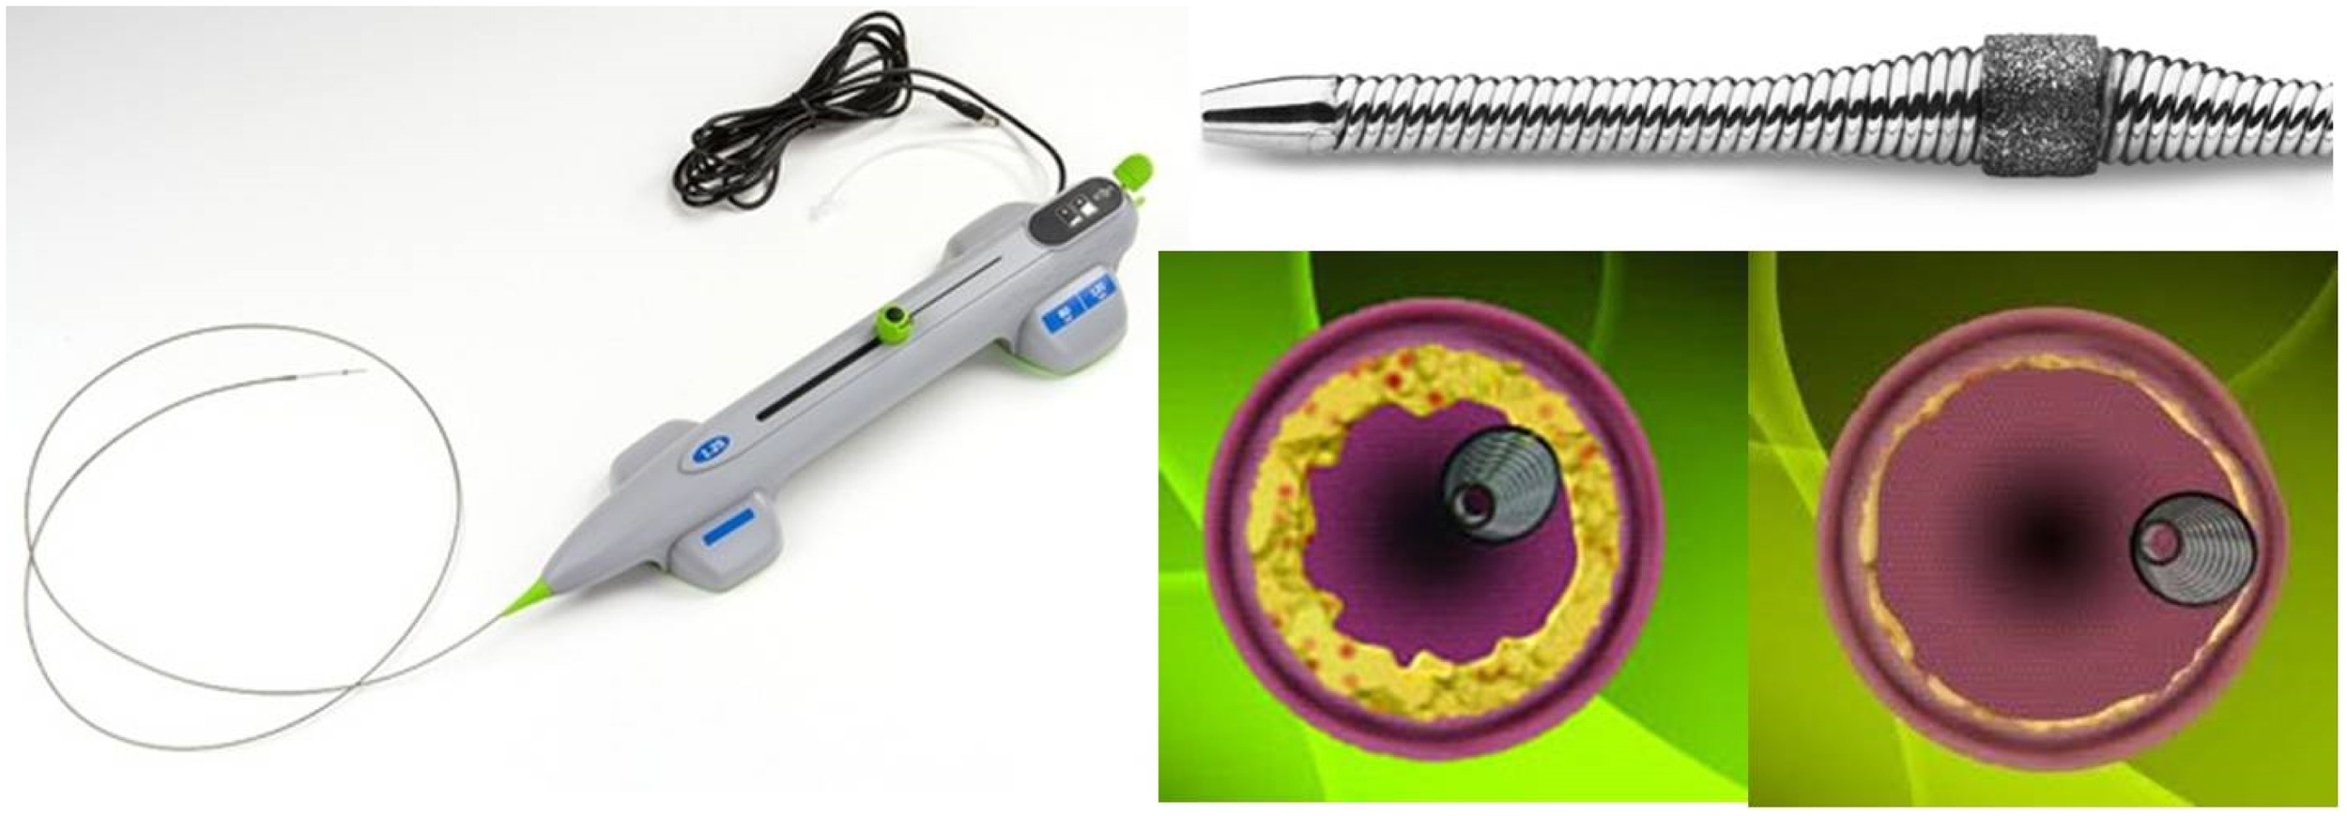

Calcified coronary lesions
Figure 29
Components of the Diamondback 360® orbital atherectomy system.
Farrel Hellig, Pieter Van Wyk, Emanuele Barbato, Shaheen Pandie
©2025 Europa Group - All rights reserved.

