Slide 1


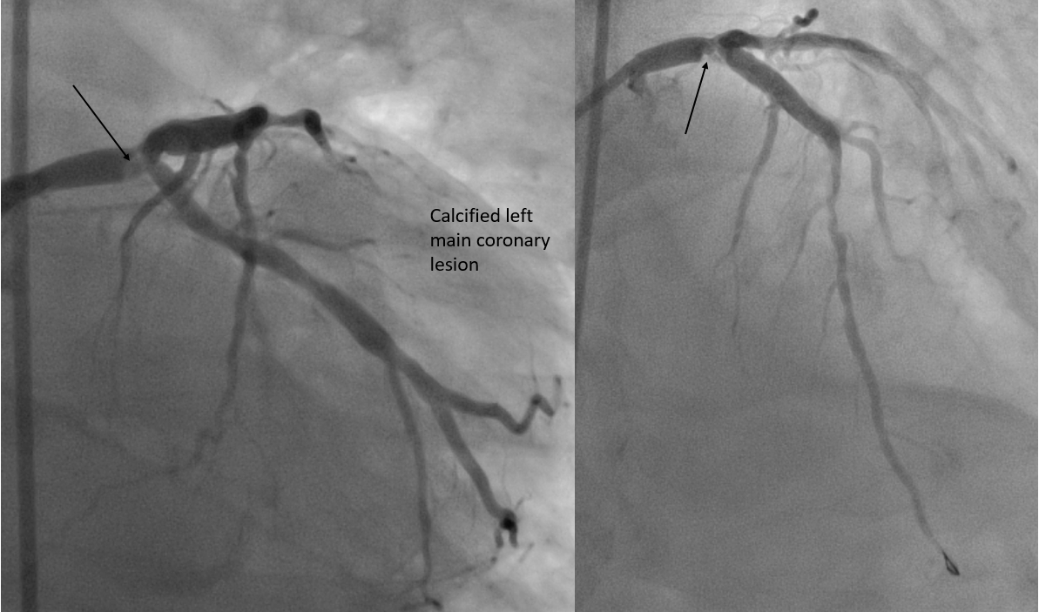

Calcified coronary lesions
Figure 3
Severe calcified plaque seen in the distal left main coronary. This lesion is very similar in appearance to what thrombus in the distal left main coronary may look like. Note the calcified lesion also seen in the mid left anterior coronary seen on the right panel.
Farrel Hellig, Pieter Van Wyk, Emanuele Barbato, Shaheen Pandie
©2025 Europa Group - All rights reserved.

