Slide 1


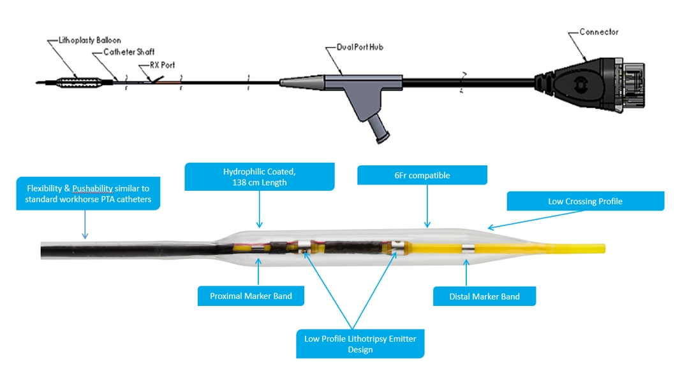

Calcified coronary lesions
Figure 34
Components of the Shockwave Medical Inc. Intravascular lithotripsy catheter.
Farrel Hellig, Pieter Van Wyk, Emanuele Barbato, Shaheen Pandie
©2025 Europa Group - All rights reserved.

