Slide 1


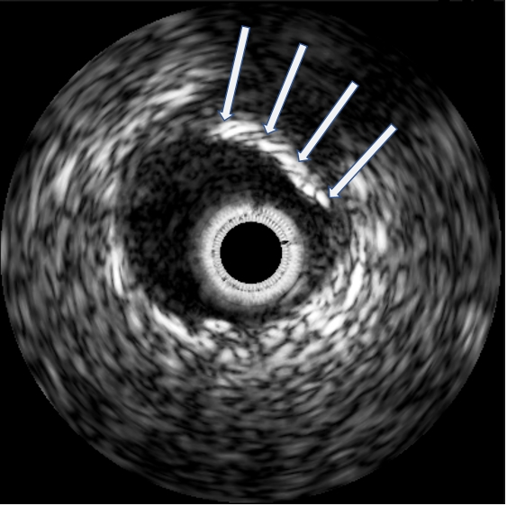

Calcified coronary lesions
Figure 4
IVUS demonstrating calcified plaque as illustrated by the arrows. Note the black acoustic shadow behind the calcium deposition.
Farrel Hellig, Pieter Van Wyk, Emanuele Barbato, Shaheen Pandie
©2025 Europa Group - All rights reserved.

