Slide 1


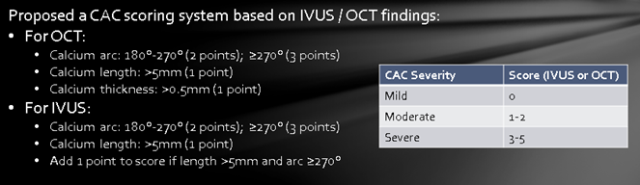
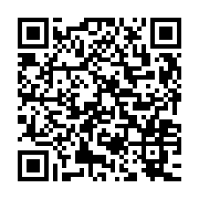
Calcified coronary lesions
Figure 6
Dini and colleges proposed a scoring system using either IVUS or OCT to evaluate coronary calcification severity (30).
Farrel Hellig, Pieter Van Wyk, Emanuele Barbato, Shaheen Pandie
©2025 Europa Group - All rights reserved.

