Slide 1


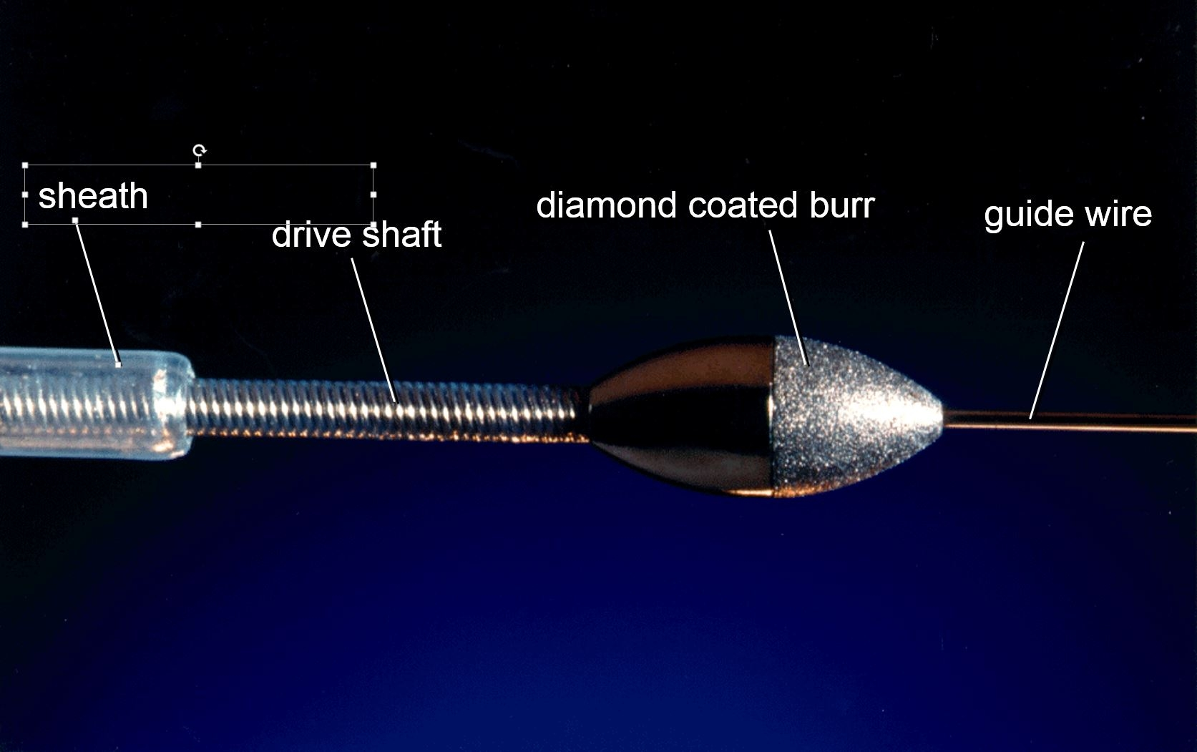

Calcified coronary lesions
Figure 7
RA burr tip. The front halve of the elliptical metallic burr tip is covered by a fine diamond crust. The burr-tip is attached to the drive shaft that is in turn covered by a Teflon sheath.
Farrel Hellig, Pieter Van Wyk, Emanuele Barbato, Shaheen Pandie
©2025 Europa Group - All rights reserved.

