Slide 1


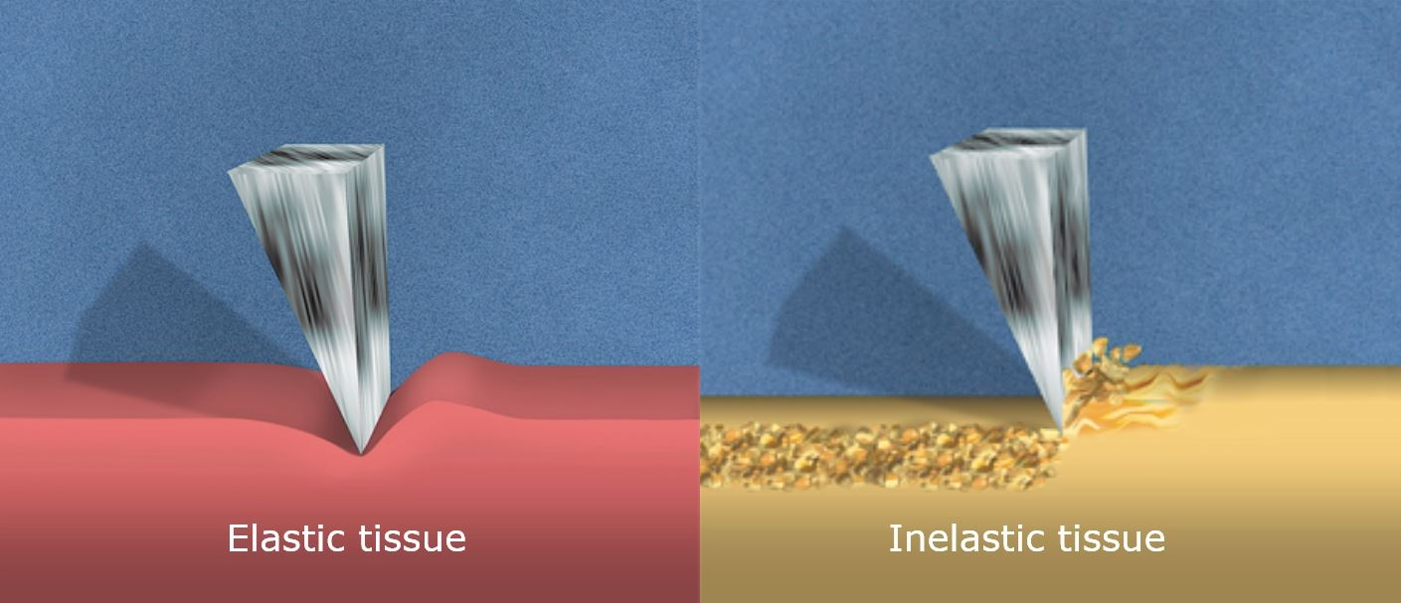

Calcified coronary lesions
Figure 8
Differential cutting during rotational atherectomy. Elastic non-calcified segments of a coronary remains unaffected during rotational atherectomy due to compliance of the vessel. Calcified plaque however is non-compliant resulting in rotational atherectomy preferentially ablating calcified lesions.
Farrel Hellig, Pieter Van Wyk, Emanuele Barbato, Shaheen Pandie
©2025 Europa Group - All rights reserved.

