Slide 1


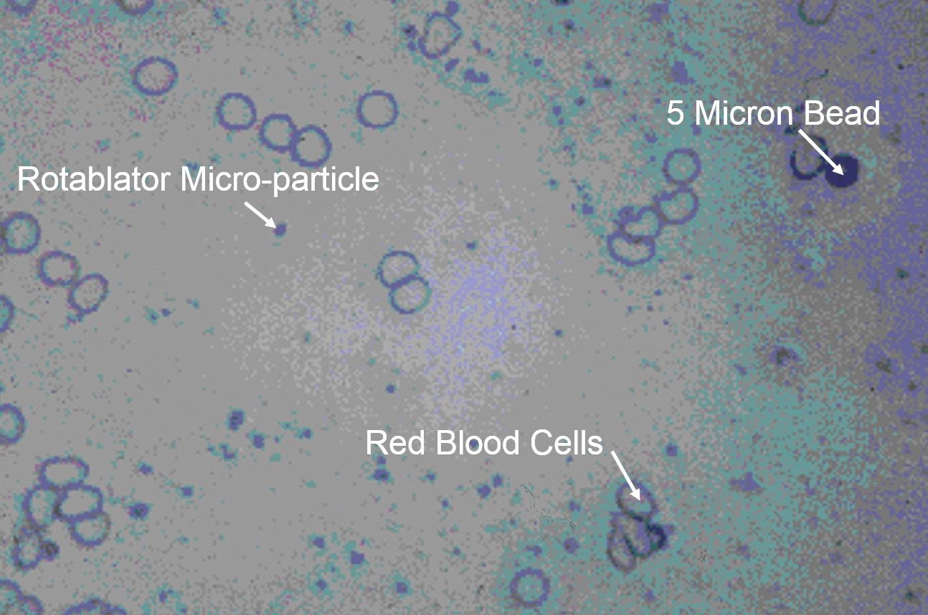

Calcified coronary lesions
Figure 9
The size of RA micro-particles in relation to red blood cells.
Farrel Hellig, Pieter Van Wyk, Emanuele Barbato, Shaheen Pandie
©2025 Europa Group - All rights reserved.

