Slide 1


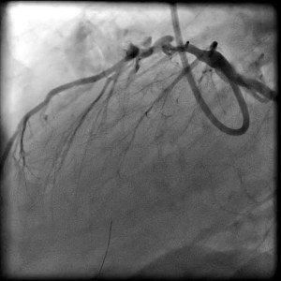

Calcified coronary lesions
Video 10
Perforation of the 1st diagonal vessel following RA.
Farrel Hellig, Pieter Van Wyk, Emanuele Barbato, Shaheen Pandie
©2025 Europa Group - All rights reserved.

