Slide 1


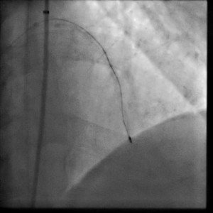

Calcified coronary lesions
Video 13
RA in subintimal space after ADR.
Farrel Hellig, Pieter Van Wyk, Emanuele Barbato, Shaheen Pandie
©2025 Europa Group - All rights reserved.

