Slide 1


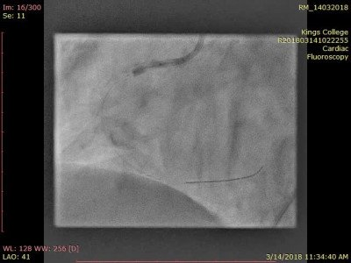

Calcified coronary lesions
Video 14
IVL demonstrating waist resolution.
Farrel Hellig, Pieter Van Wyk, Emanuele Barbato, Shaheen Pandie
©2025 Europa Group - All rights reserved.

