Slide 1


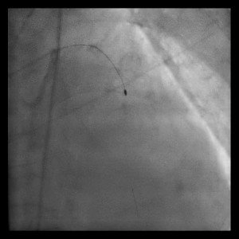

Calcified coronary lesions
Video 2
Final polishing run with RA. Following ablating a pathway through a calcified lesion with a pecking motion, rotational atherectomy is completed by a polishing run where the bur is advanced several times through the length of the lesion in a brisk manor.
Farrel Hellig, Pieter Van Wyk, Emanuele Barbato, Shaheen Pandie
©2025 Europa Group - All rights reserved.

