Slide 1


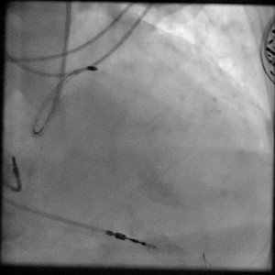

Calcified coronary lesions
Video 3
RA of a mid LAD. Flow is seen in the distal vessel prior to performing RA.
Farrel Hellig, Pieter Van Wyk, Emanuele Barbato, Shaheen Pandie
©2025 Europa Group - All rights reserved.

