Slide 1


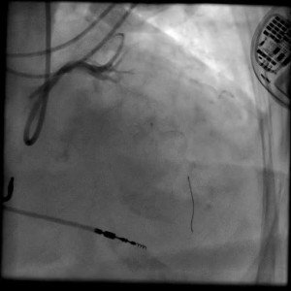

Calcified coronary lesions
Video 4
Following RA no flow is seen beyond the mid LAD.
Farrel Hellig, Pieter Van Wyk, Emanuele Barbato, Shaheen Pandie
©2025 Europa Group - All rights reserved.

