Slide 1


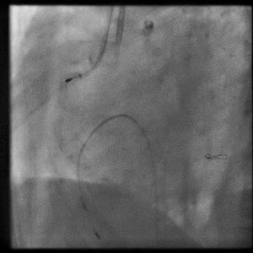

Calcified coronary lesions
Video 5
Burr entrapment during RA of RCA. Note the bur tip “jumps” through the severe angulated proximal segment of the vessel and never returns to the original starting position in the very proximal segment.
Farrel Hellig, Pieter Van Wyk, Emanuele Barbato, Shaheen Pandie
©2025 Europa Group - All rights reserved.

