Slide 1


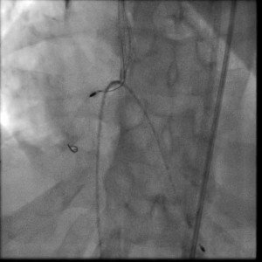

Calcified coronary lesions
Video 6
A parallel wire was passed through a 2nd guide catheter and passed adjacent to the trapped bur tip.
Farrel Hellig, Pieter Van Wyk, Emanuele Barbato, Shaheen Pandie
©2025 Europa Group - All rights reserved.

