Slide 1


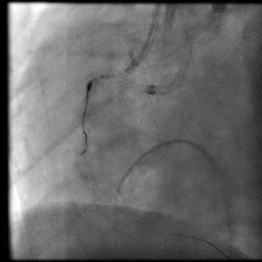

Calcified coronary lesions
Video 7
A low profile balloon passed over a parallel wire. This balloon was used to dilate adjacent to the trapped burr tip referred to as a “buddy balloon” technique.
Farrel Hellig, Pieter Van Wyk, Emanuele Barbato, Shaheen Pandie
©2025 Europa Group - All rights reserved.

