Slide 1


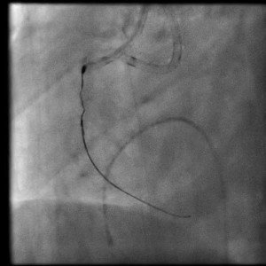

Calcified coronary lesions
Video 8
Following dilatation of the vessel adjacent to the burr tip, the burr tip was retrieved by traction of the whole RA system. Note that following burr retrieval wire position in the vessel was maintained via the parallel wire through the second guide catheter.
Farrel Hellig, Pieter Van Wyk, Emanuele Barbato, Shaheen Pandie
©2025 Europa Group - All rights reserved.

