Slide 1


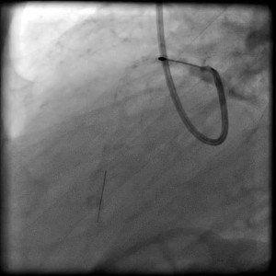

Calcified coronary lesions
Video 9
RA of LAD into the 1st diagonal branch.
Farrel Hellig, Pieter Van Wyk, Emanuele Barbato, Shaheen Pandie
©2025 Europa Group - All rights reserved.

