Slide 1


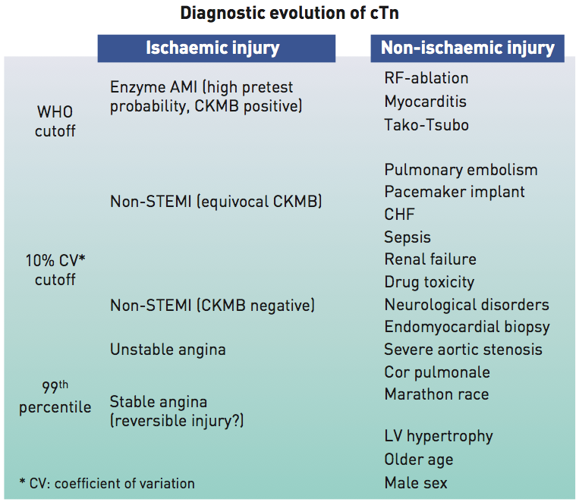

Cardiac biomarkers
Figure 2
Association between diagnostic threshold and detectable cardiovascular pathology
Evangelos Giannitsis, Christian W. Hamm, Holger M. Nef, Hugo A. Katus
©2025 Europa Group - All rights reserved.

