Slide 1


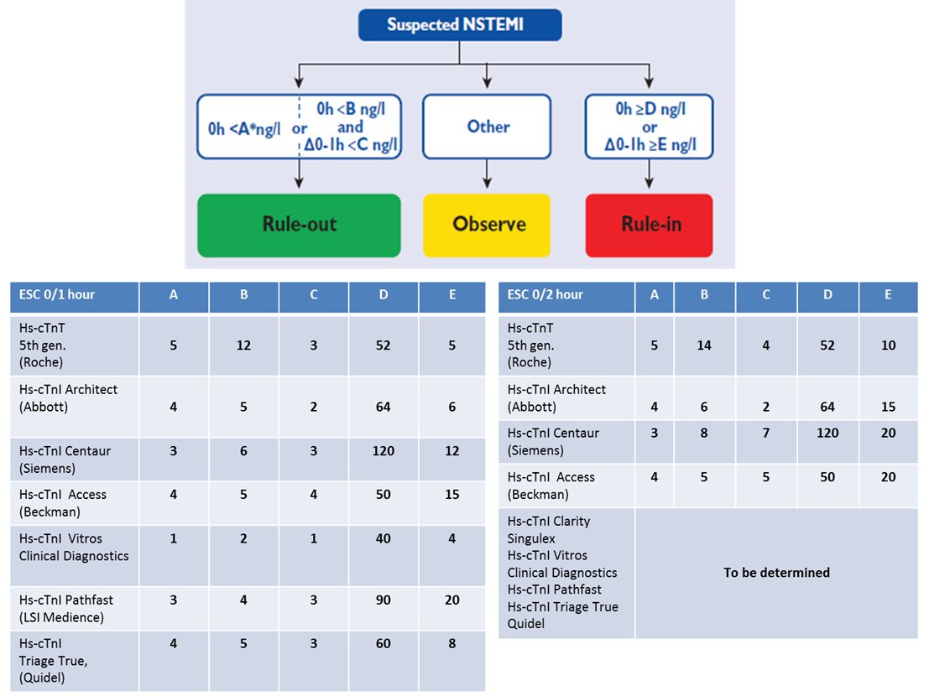

Cardiac biomarkers
Figure 3
0 h/1 h rule-out and rule-in algorithm using high-sensitivity cardiac troponin assays in patients presenting with suspected non-ST-segment elevation acute coronary syndrome to the emergency department. Cut-offs are assay specific. The asterics denotes that a rule-out based on a single hs-cTn below the limit of detection (LoD) requires that the time from chest pain onset to the baseline blood draw exceeds 3 hours. Otherwise, the use of a serial protocol is mandated.
Evangelos Giannitsis, Christian W. Hamm, Holger M. Nef, Hugo A. Katus
©2025 Europa Group - All rights reserved.

