Slide 1


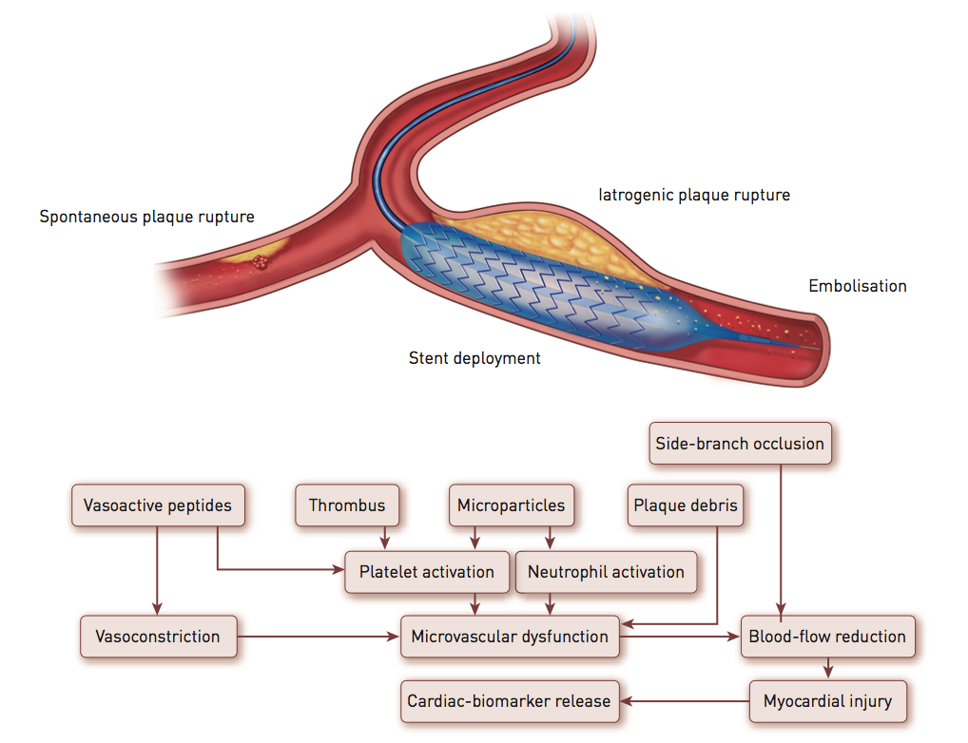

Cardiac biomarkers
Figure 4
Pathological mechanisms leading to MI, i.e., spontaneous plaque rupture (type 1 MI), downstream embolisation of plaque material or activated platelets after mechanical disruption of the plaque from balloon inflation or coronary stenting, and mechanical complications such as side branch occlusion or coronary artery dissection
Evangelos Giannitsis, Christian W. Hamm, Holger M. Nef, Hugo A. Katus
©2025 Europa Group - All rights reserved.

