Slide 1


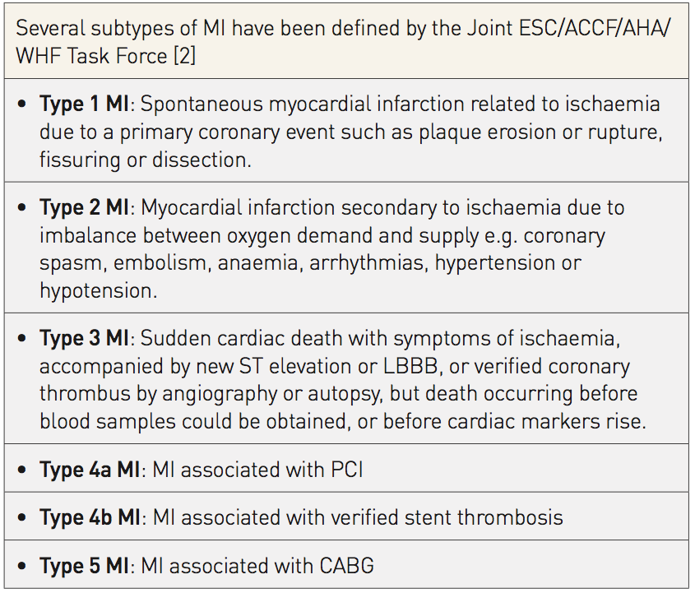

Cardiac biomarkers
Table 2
Subtypes of MI
Evangelos Giannitsis, Christian W. Hamm, Holger M. Nef, Hugo A. Katus
©2025 Europa Group - All rights reserved.

