Slide 1


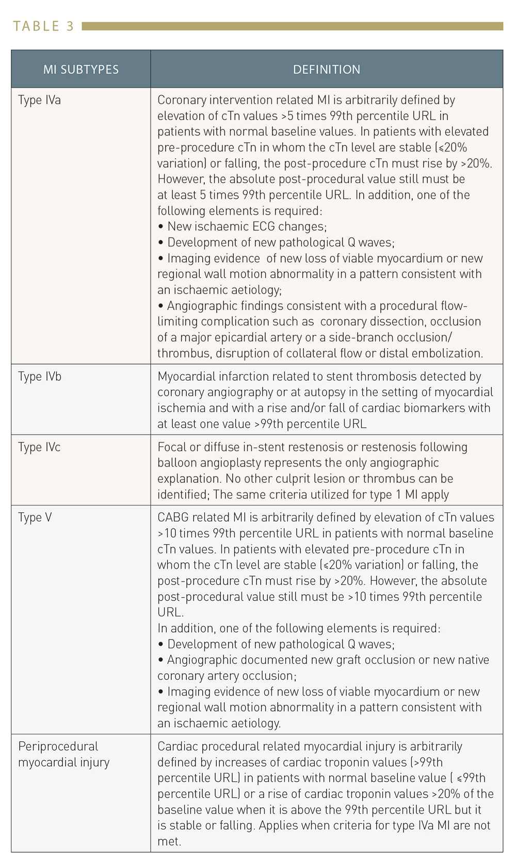

Cardiac biomarkers
Table 3
Subtypes of prodedure-related MI and periprocedural myocardial injury
Evangelos Giannitsis, Christian W. Hamm, Holger M. Nef, Hugo A. Katus
©2025 Europa Group - All rights reserved.

