Slide 1


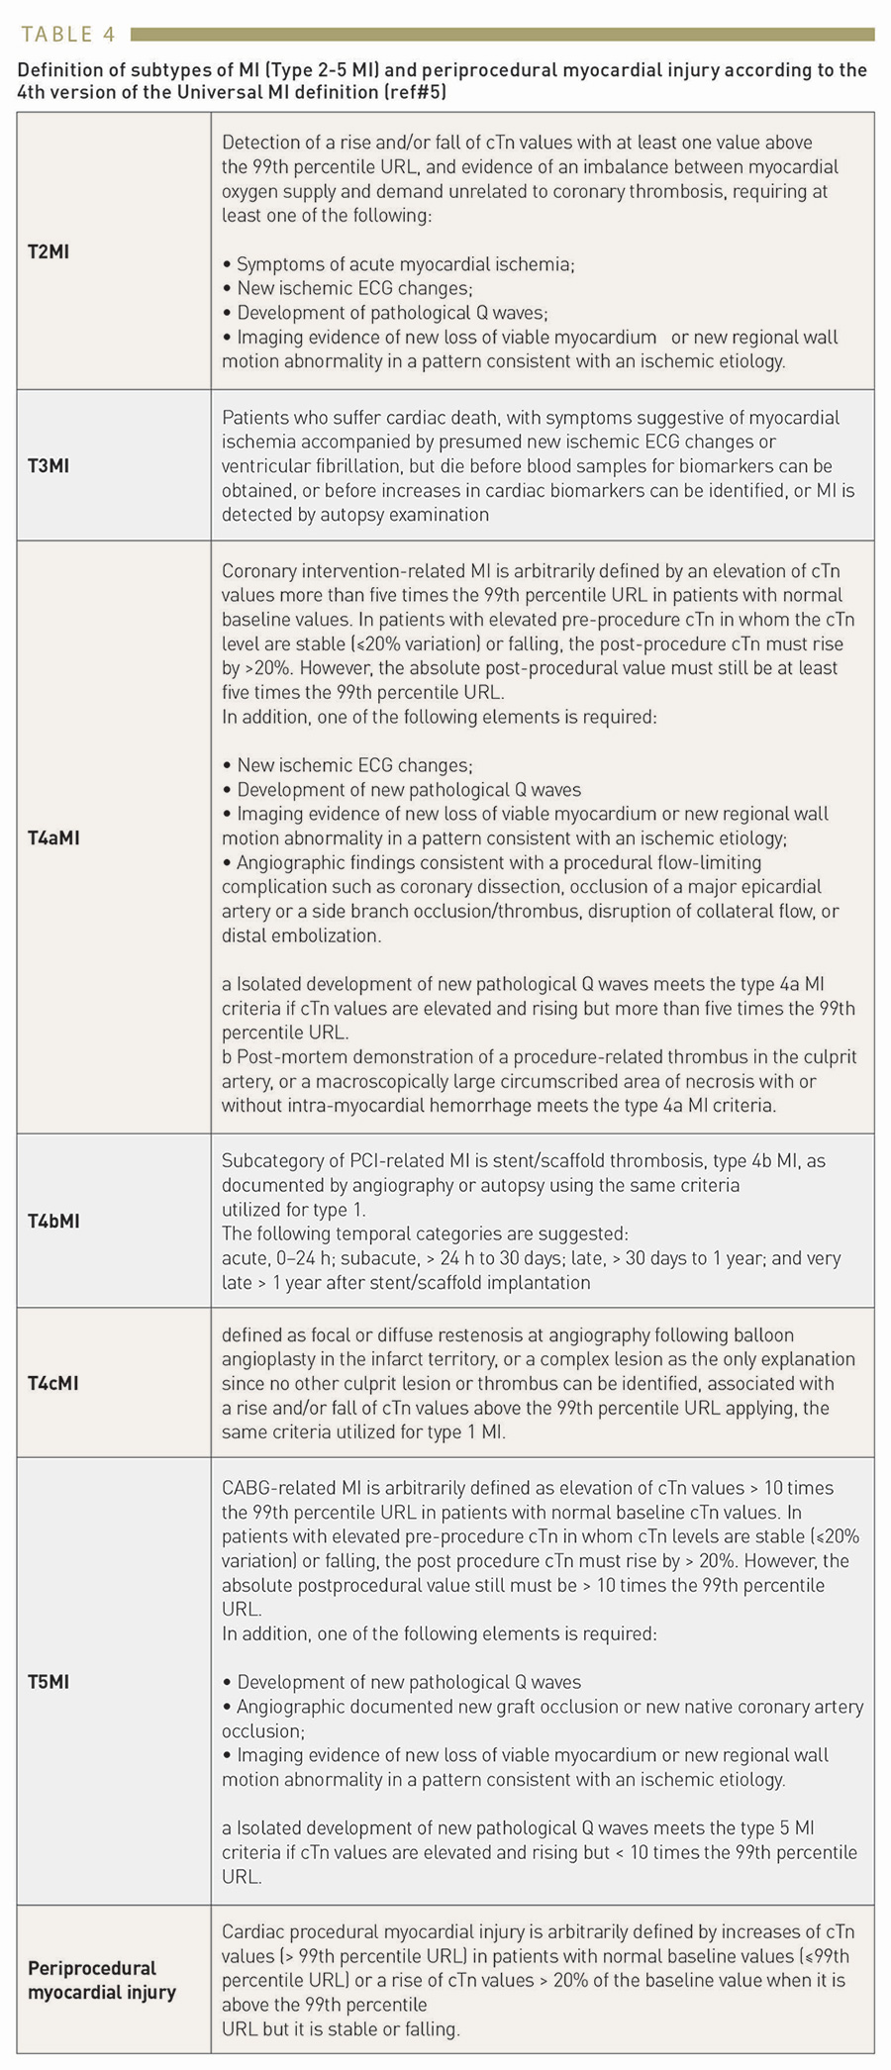

Cardiac biomarkers
Table 4
Definition of subtypes of MI (Type 2-5 MI) and periprocedural myocardial injury according to the 4th version of the Universal MI definition (ref#5)
Evangelos Giannitsis, Christian W. Hamm, Holger M. Nef, Hugo A. Katus
©2025 Europa Group - All rights reserved.

