Slide 1


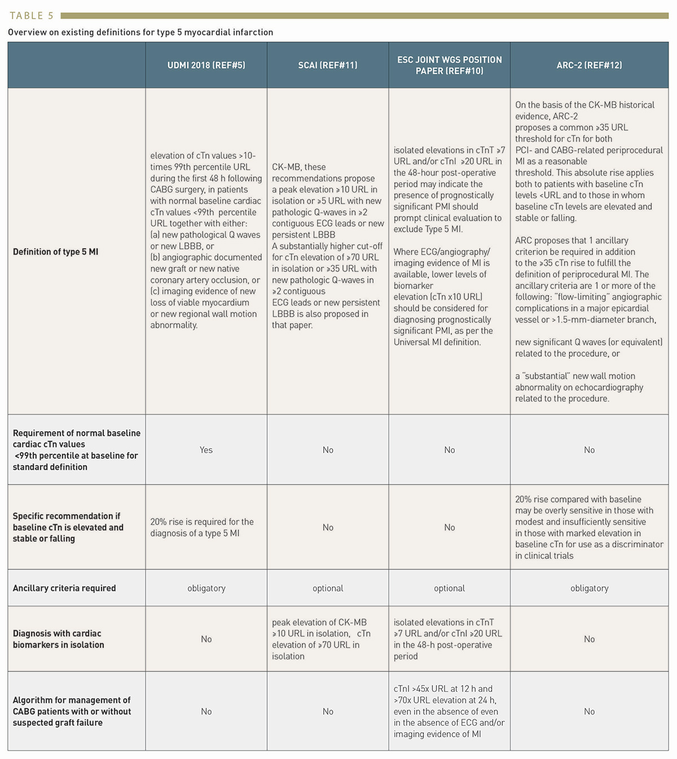

Cardiac biomarkers
Table 5
Overview on existing definitions for type 5 myocardial infarction
Evangelos Giannitsis, Christian W. Hamm, Holger M. Nef, Hugo A. Katus
©2025 Europa Group - All rights reserved.

