Slide 1


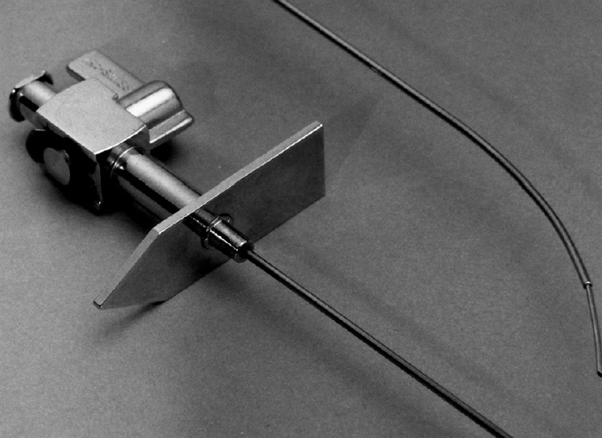

Cardiac transseptal catheterisation
Figure 1
Brockenbrough needle. The distal curve corresponds to the direction of the arrow at the hub.
Gregory Ducrocq, Thomas R.D. Shaw, Habib Gamra, Peter C. Block, Neil R. Grubb, Carlos E. Ruiz, Alec Vahanian
©2025 Europa Group - All rights reserved.

