Slide 1


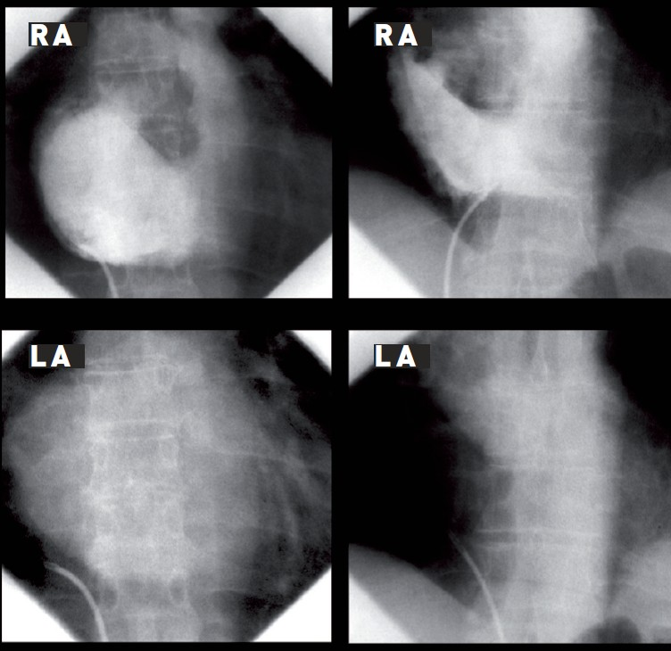

Cardiac transseptal catheterisation
Figure 10
Right atrial contrast injection with follow-through to identify RA/LA overlap in anteroposterior projection. Left panel: extensive overlap in mitral stenosis. Right panel: marked anatomical variation in a patient with aortic stenosis and an intrapericardial cyst. Successful puncture was achieved. LA, left atrium/atrial; RA, right atrium/atrial.
Gregory Ducrocq, Thomas R.D. Shaw, Habib Gamra, Peter C. Block, Neil R. Grubb, Carlos E. Ruiz, Alec Vahanian
©2025 Europa Group - All rights reserved.

