Slide 1


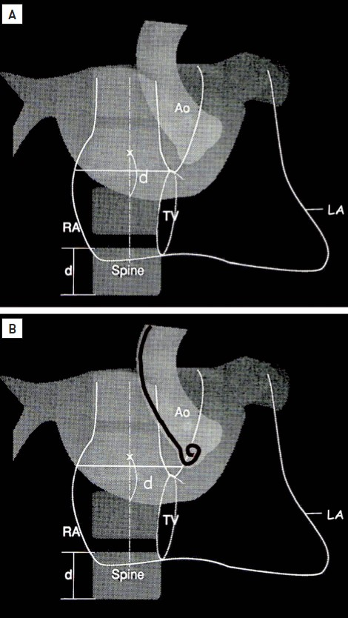

Cardiac transseptal catheterisation
Figure 11
(A) Inoue et al.'s method, using right atrial to left atrial contrast. (B) Hung's method, using fluoroscopy. Ao, aorta; d, distance; LA, left atrium; RA, right atrium; TV, tricuspid valve.
Gregory Ducrocq, Thomas R.D. Shaw, Habib Gamra, Peter C. Block, Neil R. Grubb, Carlos E. Ruiz, Alec Vahanian
©2025 Europa Group - All rights reserved.

