Slide 1


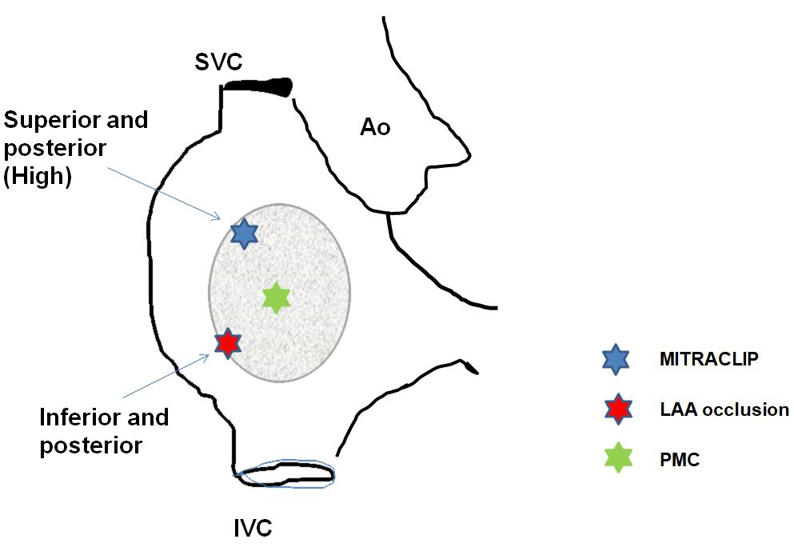

Cardiac transseptal catheterisation
Figure 14
Specific site of transseptal puncture according to indication. Ao: aorta; IVC: inferior vena cava; SVC: superior vena cava.
Gregory Ducrocq, Thomas R.D. Shaw, Habib Gamra, Peter C. Block, Neil R. Grubb, Carlos E. Ruiz, Alec Vahanian
©2025 Europa Group - All rights reserved.

