Slide 1


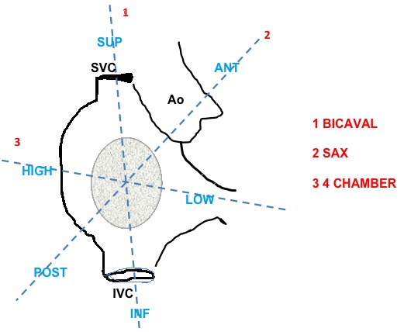

Cardiac transseptal catheterisation
Figure 15
Echocardiographic terminology for site selection of transseptal puncture. ANT, anterior; Ao, aorta; INF, inferior; IVC, inferior vena cava; POST, posterior; SAX, Short Axis; SUP, superior; SVC, superior vena cava.
Gregory Ducrocq, Thomas R.D. Shaw, Habib Gamra, Peter C. Block, Neil R. Grubb, Carlos E. Ruiz, Alec Vahanian
©2025 Europa Group - All rights reserved.

