Slide 1


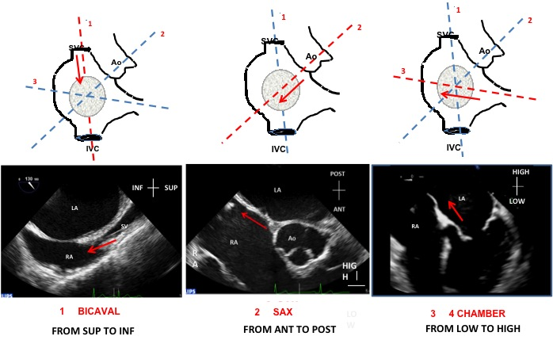

Cardiac transseptal catheterisation
Figure 16
Use of the three sequential transoesophageal echocardiography planes (schematic illustration in upper panel, echocardiograms in lower panel) to guide transseptal puncture: (A) bicaval, from superior to inferior; (B) Short-axis view, from anterior to posterior; and (C) four chamber, from low to high. ANT, anterior; Ao, aorta; INF, inferior; IVC, inferior vena cava; LA, left atrium; POST, posterior; RA, right atrium; SUP, superior; SVC, superior vena cava.
Gregory Ducrocq, Thomas R.D. Shaw, Habib Gamra, Peter C. Block, Neil R. Grubb, Carlos E. Ruiz, Alec Vahanian
©2025 Europa Group - All rights reserved.

