Slide 1


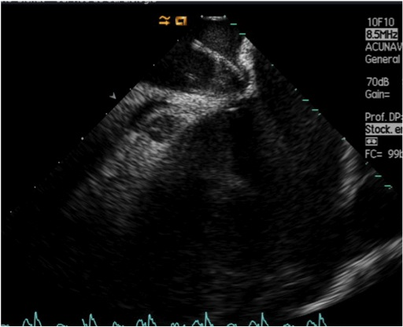

Cardiac transseptal catheterisation
Figure 18
Identification of a tent-like doming of the interatrial septum by intracardiac echocardiography.
Gregory Ducrocq, Thomas R.D. Shaw, Habib Gamra, Peter C. Block, Neil R. Grubb, Carlos E. Ruiz, Alec Vahanian
©2025 Europa Group - All rights reserved.

