Slide 1


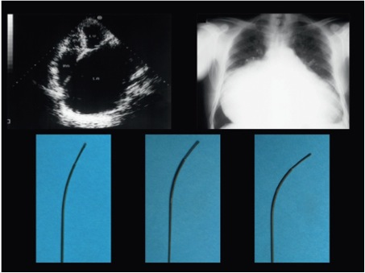

Cardiac transseptal catheterisation
Figure 19
Very marked enlargement of the left atrium (left) on echocardiography and right atrium (right) on X-ray with the needle curve (lower panel) altered to adjust to the abnormal anatomy.
Gregory Ducrocq, Thomas R.D. Shaw, Habib Gamra, Peter C. Block, Neil R. Grubb, Carlos E. Ruiz, Alec Vahanian
©2025 Europa Group - All rights reserved.

