Slide 1


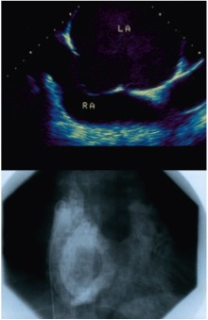

Cardiac transseptal catheterisation
Figure 20
Atrial septal aneurysm as seen by echocardiography (upper panel) and on contrast injection into the LA (lower panel). LA, left atrium; RA, right atrium.
Gregory Ducrocq, Thomas R.D. Shaw, Habib Gamra, Peter C. Block, Neil R. Grubb, Carlos E. Ruiz, Alec Vahanian
©2025 Europa Group - All rights reserved.

