Slide 1


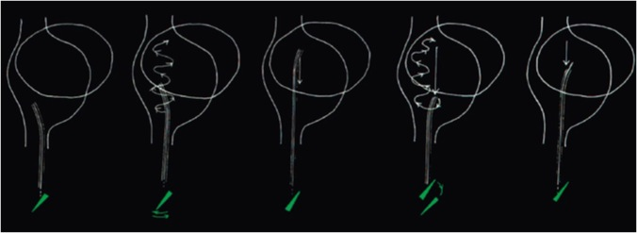

Cardiac transseptal catheterisation
Figure 21
The "anterior staircase" technique. When the catheter/needle reaches the inferior portion of the LA, it is rotated to have the curve pointing to 12 o’clock. The catheter/needle is then advanced to the top of the LA while moving the tip continually from side to side to confirm no snagging. As the inferior vena cava enters the RA posteriorly there is space within the RA cavity to accommodate the curve. The catheter/needle is then rotated again to a posterior position and drawn down the septum. LA, left atrium; RA, right atrium.
Gregory Ducrocq, Thomas R.D. Shaw, Habib Gamra, Peter C. Block, Neil R. Grubb, Carlos E. Ruiz, Alec Vahanian
©2025 Europa Group - All rights reserved.

