Slide 1


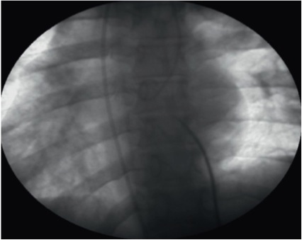

Cardiac transseptal catheterisation
Figure 22
Transseptal puncture in case of dextrocardia situs inversus.
Gregory Ducrocq, Thomas R.D. Shaw, Habib Gamra, Peter C. Block, Neil R. Grubb, Carlos E. Ruiz, Alec Vahanian
©2025 Europa Group - All rights reserved.

