Slide 1


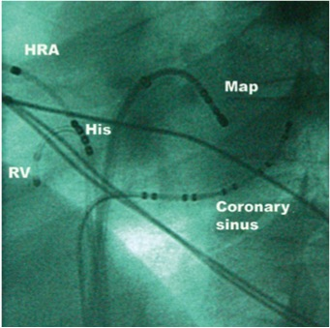

Cardiac transseptal catheterisation
Figure 23
Left anterior oblique fluoroscopic view of electrophysiology catheters. HRA, high right atrium; RV, right ventricle.
Gregory Ducrocq, Thomas R.D. Shaw, Habib Gamra, Peter C. Block, Neil R. Grubb, Carlos E. Ruiz, Alec Vahanian
©2025 Europa Group - All rights reserved.

