Slide 1


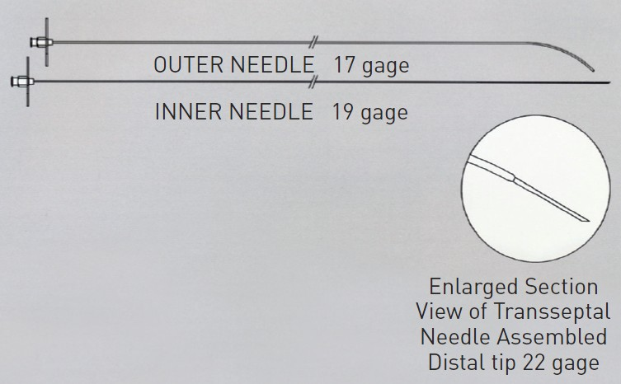

Cardiac transseptal catheterisation
Figure 4
Endrys needle and inner needle.
Gregory Ducrocq, Thomas R.D. Shaw, Habib Gamra, Peter C. Block, Neil R. Grubb, Carlos E. Ruiz, Alec Vahanian
©2025 Europa Group - All rights reserved.

