Slide 1


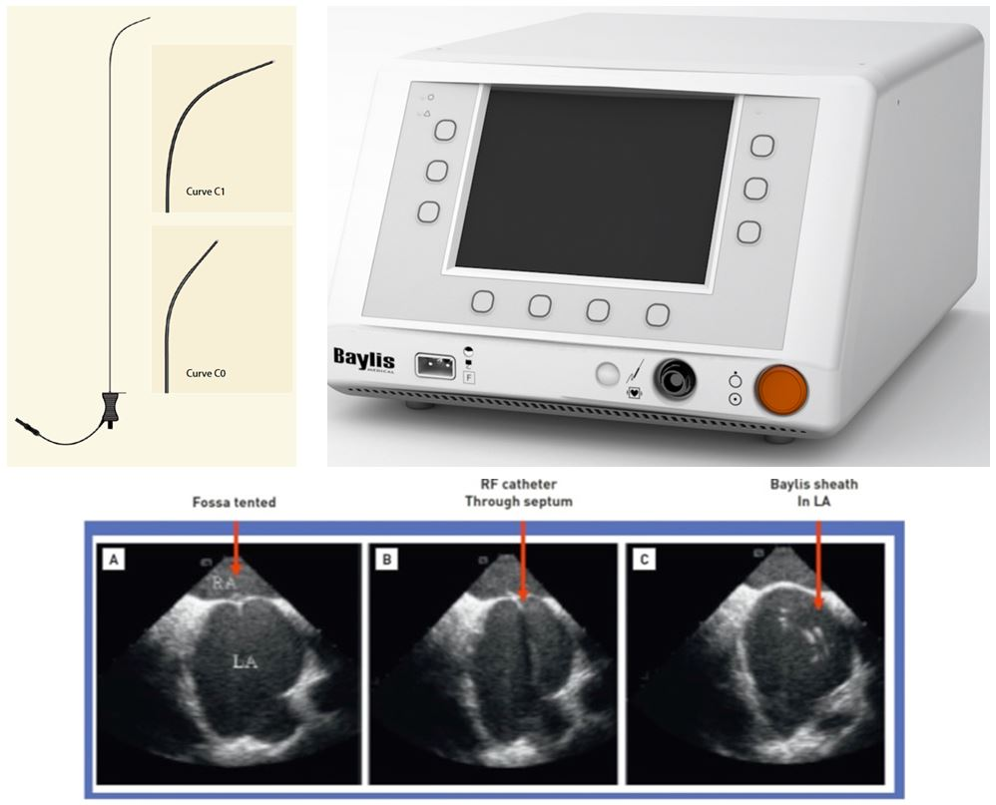

Cardiac transseptal catheterisation
Figure 5
NRG transseptal needle (Baylis Medical, Montreal, Canada), (upper left) and generator (upper right). Lower panel: Puncturing the septum with the Baylis curved tip catheter: (A) fossa tented; (B) radiofrequency catheter through septum; and (C) Baylis sheath in left atrium (LA).
Gregory Ducrocq, Thomas R.D. Shaw, Habib Gamra, Peter C. Block, Neil R. Grubb, Carlos E. Ruiz, Alec Vahanian
©2025 Europa Group - All rights reserved.

