Slide 1


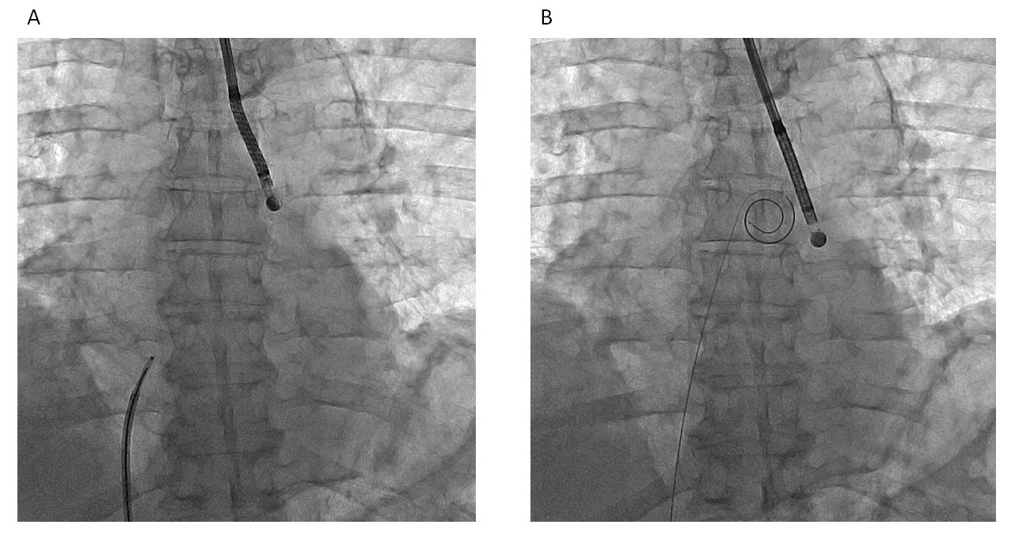

Cardiac transseptal catheterisation
Figure 6
VersaCross radiofrequency-wire based platform (Baylis Medical, Montreal, Canada). (A) Wire in the catheter (left) and wire in pigtail shape after crossing the septum (right).
Gregory Ducrocq, Thomas R.D. Shaw, Habib Gamra, Peter C. Block, Neil R. Grubb, Carlos E. Ruiz, Alec Vahanian
©2025 Europa Group - All rights reserved.

