Slide 1


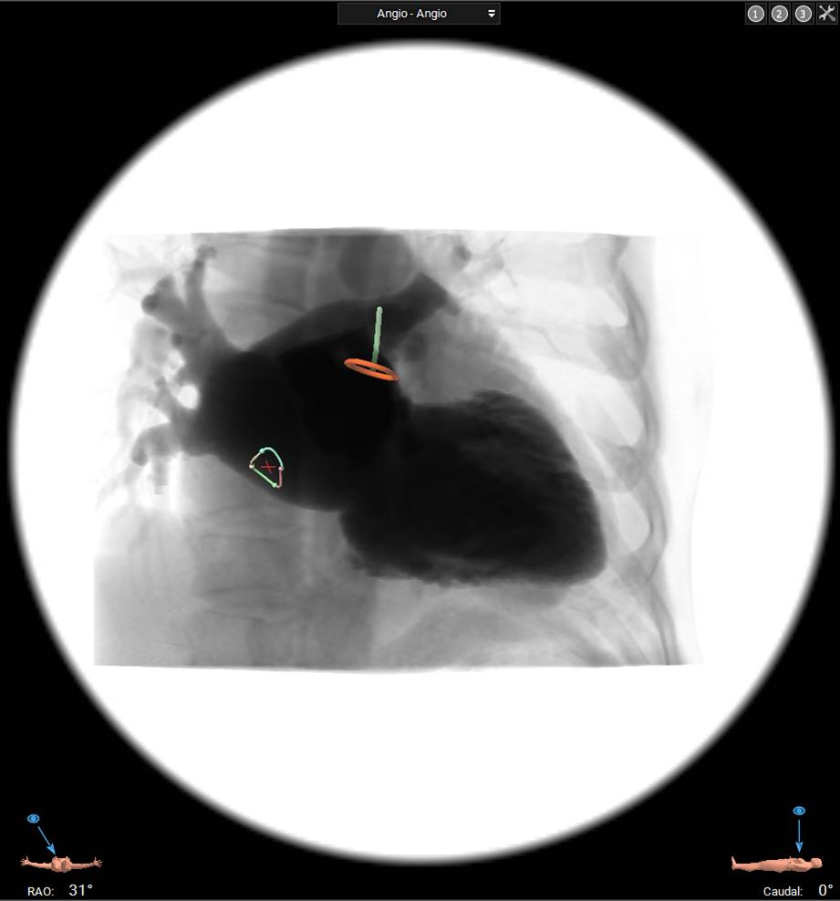

Cardiac transseptal catheterisation
Figure 8
Multislice computed tomography with three-dimensional reconstruction for planning left atrial appendage occlusion. Fossa ovalis and left atrial appendage are identified to target optimal transseptal puncture. RAO, right anterior oblique.
Gregory Ducrocq, Thomas R.D. Shaw, Habib Gamra, Peter C. Block, Neil R. Grubb, Carlos E. Ruiz, Alec Vahanian
©2025 Europa Group - All rights reserved.

