Slide 1


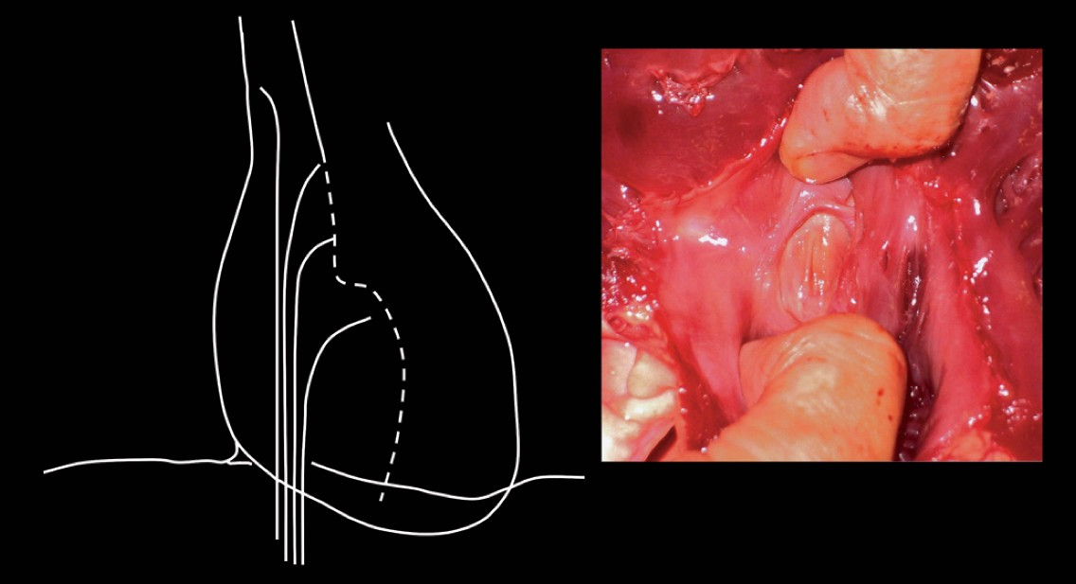

Cardiac transseptal catheterisation
Figure 9
Finding the limbic edge. Left panel: schematic illustration of withdrawing the catheter needle assembly from the superior vena cava to the fossa ovalis. Right panel: pathological specimen showing fossa ovalis with the superior limbic edge.
Gregory Ducrocq, Thomas R.D. Shaw, Habib Gamra, Peter C. Block, Neil R. Grubb, Carlos E. Ruiz, Alec Vahanian
©2025 Europa Group - All rights reserved.

