Slide 1


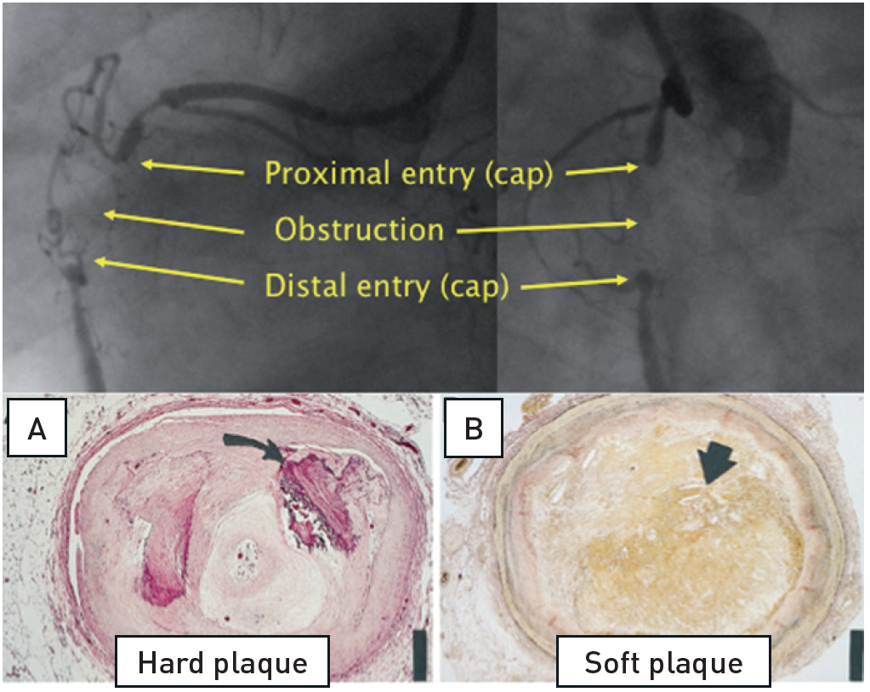

Chronic total occlusions
Figure 1
The basic features of a CTO of the RCA with the proximal and distal cap, and a variable length of occlusion in-between. Histological cross sections of various morphological compositions (adapted from [5]). A. Hematoxylin-eosin stain) of a representative hard or fibrocalcific chronic total occlusion (CTO) with extensive calcification (arrow). B, Low power view (elastic van Gieson stain) of a representative soft or lipid-laden CTO intimal plaque with extensive cholesterol deposition (arrow).
Gerald S. Werner
©2025 Europa Group - All rights reserved.

