Slide 1


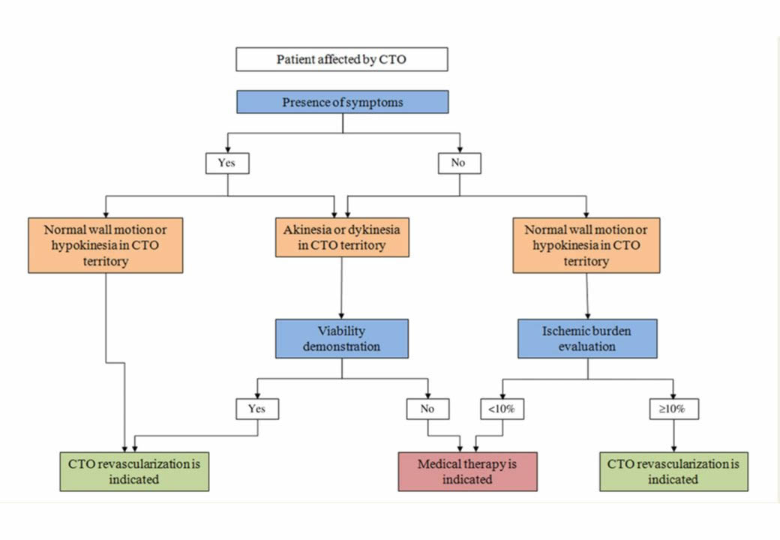

Chronic total occlusions
Figure 10
Indications of CTO revascularization according to symptoms, ischaemia, and viability. CTO, chronic total occlusion. (from [164]).
Gerald S. Werner
©2025 Europa Group - All rights reserved.

