Slide 1


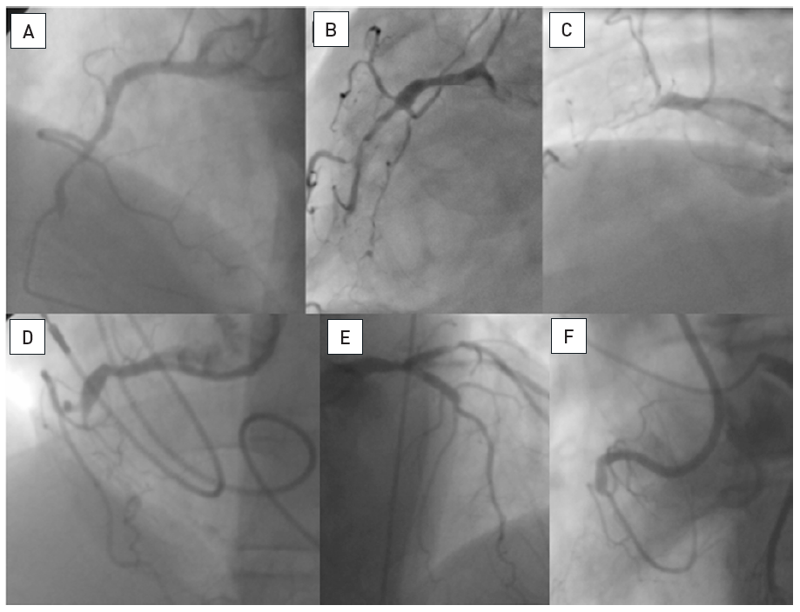

Chronic total occlusions
Figure 12
Examples of angiographic occlusion morphologyCases A-C with tapered entry: (A) was successfully crossed with a Fielder XT as the initial choice; (B) was tried with a Fielder XT, but was not crossed to the distal lumen, and wire step-up was necessary (Miracle 3G, Confianza Pro 9); (C) Fielder XT and Miracle 3G could not penetrate, but a Confianza Pro 9 did. Cases D-F with blunt entry or side branch takeoff: (D) penetration was achieved with Progress 200T after Fielder XT failed; (E) penetration was achieved with Confianza Pro 9 after Fielder XT failed; (F) was penetrated by Confianza Pro 9 initially but went subintimal, this case was solved after switching to the retrograde approach.
Gerald S. Werner
©2025 Europa Group - All rights reserved.

