Slide 1


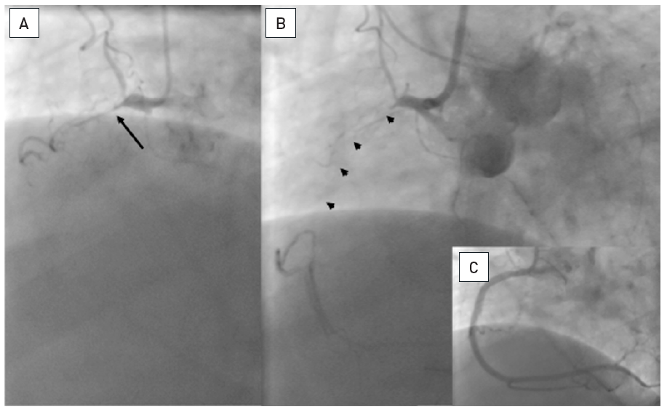

Chronic total occlusions
Figure 13
Proximal occlusion of the RCA with tapered entry (arrow), but no information on the length and presumed vessel course from the antegrade injection (A). Only the simultaneous bilateral injection reveals the length and direction of the occlusion (arrow heads, B). (C): Result after antegrade recanalisation.
Gerald S. Werner
©2025 Europa Group - All rights reserved.

