Slide 1


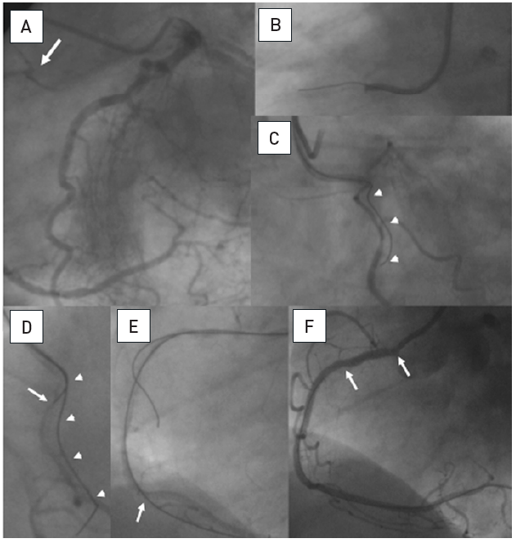

Chronic total occlusions
Figure 14
A. Short RCA occlusion located right at the ostium (arrow), well collateralised from the left coronary artery. B. Difficult and imperfect seating of a guiding catheter (Amplatz right 6F) with a Miracle 3G (ASAHI Intecc). C. The RAO view cranial angulation shows the paravascular wire position, however, this wire now served as an anchor for the guiding catheter, which enabled a better alignment towards the true vessel course. D. With realignment due to the advanced first wire, a second parallel Miracle 3G wire is now advanced with a better angle to the true lumen (arrow). E. Now the second wire is clearly intraluminal as verified with repeated contralateral injections and further advanced distally, where it entered a side branch (arrow). F: After balloon dilatation and a singular Taxus stent (between arrows) perfect antegrade flow is re-established.
Gerald S. Werner
©2025 Europa Group - All rights reserved.

