Slide 1


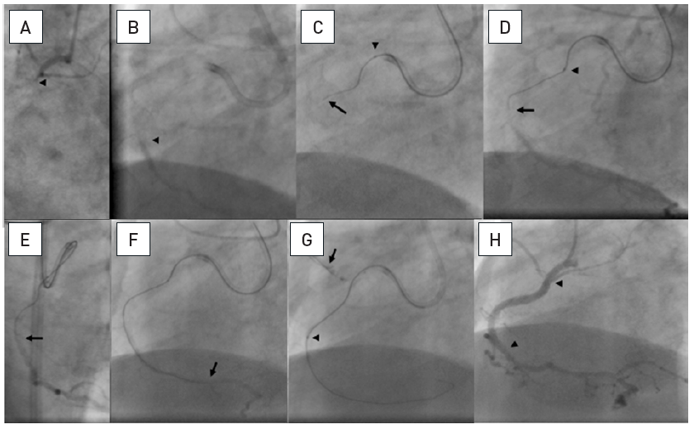

Chronic total occlusions
Figure 15
A 20 mm long occlusion of the proximal RCA with a tapered entry (arrow head, A), and the distal target beyond a bend (arrow head, B). Sequence shown in clockwise direction. A 6 Fr Amplatz left 1 side hole guide is used. Despite angiographic signs of calcification ©, a Fielder XT wire (arrow) is advanced relatively easily far into the occlusion supported by a FineCross microcatheter (arrow head).The wire is advanced gently further around the vessel bend towards the distal target (arrow, D). Entry into the distal lumen is verified in RAO (arrow, E) and orthogonal LAO views, and advanced further (arrow, F). The calcification of the vessel with a sharp bend prevented the advancement of a low-profile balloon. This was overcome by an anchoring balloon in a proximal side branch (arrow) which enabled the progress of the balloon (arrow head, G). Subsequently further balloon dilatation and stent placement (between arrow heads, H) was accomplished with the help of the anchor balloon.
Gerald S. Werner
©2025 Europa Group - All rights reserved.

