Slide 1


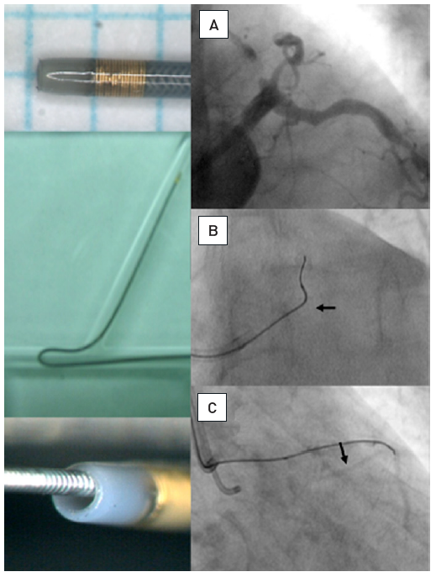

Chronic total occlusions
Figure 16
Example of a modern microcatheter FineCross MG [Terumo] with a braided shaft and tipThe tip marker is positioned close to the distal tip which is tapered for better entry profile. The inner lumen holding the guidewire is larger than in an OTW-balloon; the braided shaft prevents kinking. Application of a microcatheter: (A) Proximal occlusion of the LAD, the distal target filled by simultaneous injection through bilateral injections. (B) To enter the proximal segment, a sharp wire angle is required. With this, the microcatheter (arrow) is advanced proximal to the occlusion. (C) Then the wire tip is reshaped and the wire (Miracle 3G) advanced safely into the distal true lumen as visualised by contralateral injection.
Gerald S. Werner
©2025 Europa Group - All rights reserved.

